Slide 1


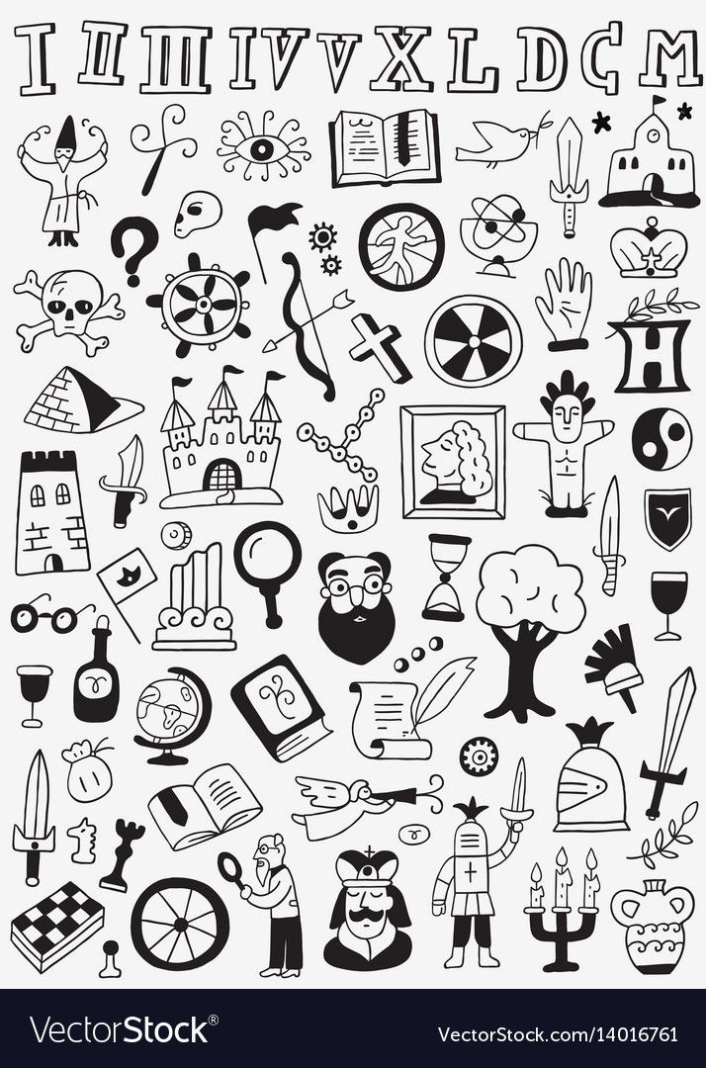



Welcome to our AI based Ticket booking site for Museum!
MUSEBEE

Slide 2











En
Where would you like to visit?
Users can select their language and city or choose popular options for a quick search. The "Tap to Chat" feature connects them to the AI chatbot for seamless, personalized ticket booking.
Kolkata |
Auto detect
Popular cities
TAP TO CHAT
May
I Help!!
Bot !!
Hey !!

Slide 3
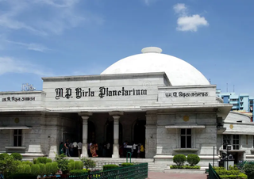


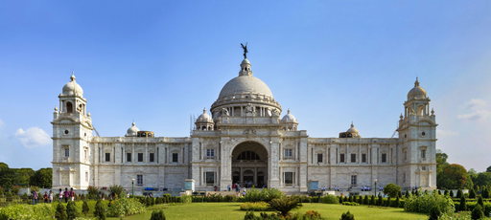
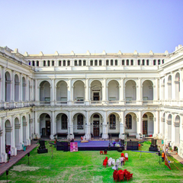
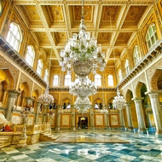
Search results display museums in various cities with detailed lists, popular spots, and personalized recommendations. Users can easily select top-rated venues and access relevant information on each location.
Results...
Hyderabad
Kolkata
Mumbai
Bangalore
Birla Planetorium
Kolkata
Favourite Places
Victoria Memorial
Kolkata
The Victoria Memorial in Kolkata, India, is a grand marble structure built in memory of Queen Victoria. It houses a museum with British-era relics and serves as a popular tourist attraction.
Indian Museum
Kolkata
The Victoria Memorial in Kolkata, India, is a grand marble structure built in memory of Queen Victoria. It houses a museum with British-era relics and serves as a popular tourist attraction.
Nizam Palace
Kolkata
The Victoria Memorial in Kolkata, India, is a grand marble structure built in memory of Queen Victoria. It houses a museum with British-era relics and serves as a popular tourist attraction.

Slide 4
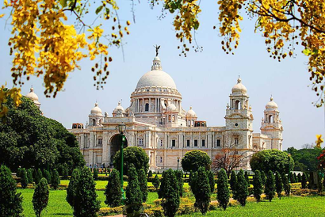


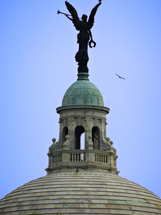
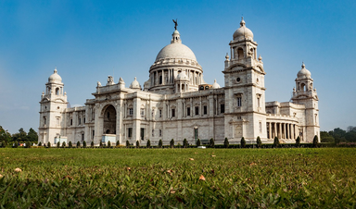
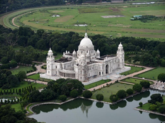
Place details
User selects Victoria Memorial -
Each place includes a brief description and pictures, giving users a comprehensive view and enhancing their travel experience with visual and text-based insights.
Victoria Memorial
Kolkata
The Victoria Memorial in Kolkata, India, is a grand marble structure built in memory of Queen Victoria. It houses a museum with British-era relics and serves as a popular tourist attraction.
Pictures

Slide 5


Hi, which tickets do you want to book?
dfdsf
It offers a friendly and personalized experience.
Enhancing user engagement with a smooth and efficient conversational approach.
Two tickets for Indian Museum
....
|

Slide 6



Hi, which tickets do you want to book?
Our intuitive system simplifies ticketing with quick, personalized responses and seamless payment and cancellation handling for a hassle-free experience.
dfdsf
Two tickets for Indian Museum
Please State your prefered date and timing.
dfdsf
19th July, 11 Am.
Okay, booking 2 tickets for Indian Museum, on 19th July, 11AM. Please pay to proceed further.
Pay using
Change
>
Google Pay
Slide to pay |
220

Slide 7

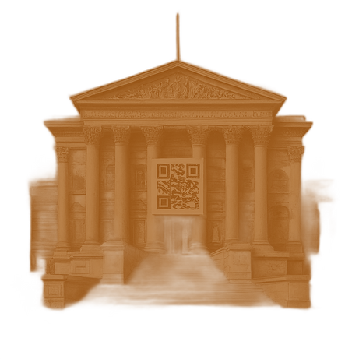
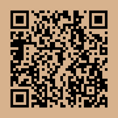


thank
you
After booking, users can download their receipt for easy access to transaction details and future reference.
Your ticket has been
booked successfully
-Museum-
Adult
2
Child
2
Reference Id: AV05Fs
Download Receipt

Slide 8


Get a detailed breakdown of the booking. Offering a download option for the invoice to ensure transparency and allowing users to keep a record of their payment for future reference.
INVOICE
Date:
Time:
08/09/202
06:30 PM
GST NO : XXXXXXXXXX
Indian Museum
Tax Breakdown
NET :
GST :
ETAX :
User :
Transaction ID : XXXXX
XXX
XXX
XXX
XXXX
XXXXX
Thank You !!
Keep Buzzing !!

Slide 9

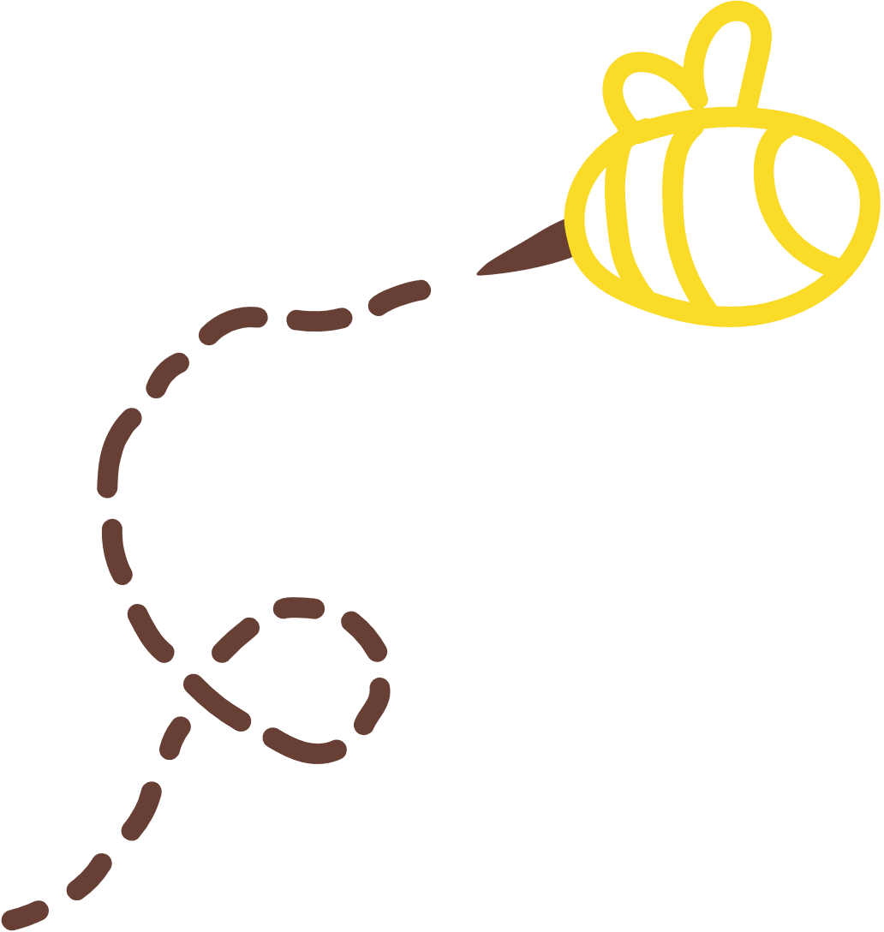
Thank You for your time!
Keep buzzing from place to placee....

